Slide 1
Roman Legends and Roman Values
Alan Haffa
Please Silence your Cell Phone

Slide 2
Legends of Rome
Legend, Myth, and History
Ennius (239-169 B.C.): Father of Roman Poetry; Spoke Greek; Annals, an Epic that covers Roman history from Fall of Troy to Cato the Elder; Source for Vergil
Titus Livius (Livy) 59 B.C.-17 A.D.: Ab Urbe Condite (From the Founding of the City)
Prose Counterpart of Vergil as Golden Age Roman Literature
Vergil in the Aeneid; Ovid in Metamorphoses

Slide 3
Characteristics of Roman Myth
Focus on origins of City and Early History
Patriarchal Perspective
Demythologizing Tendency
Roman Transformation of Greek Myth
Politicizing of Myth

Slide 4
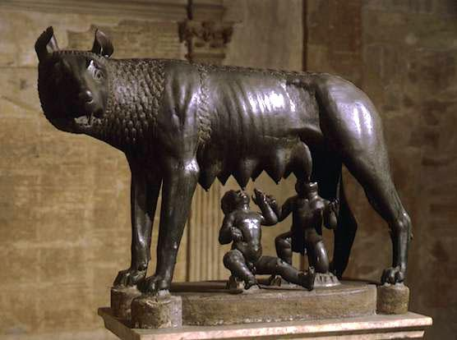
Romulus and Remus
Born to Rhea Silvia, daughter of King of Alba Longa, and Mars
King Amulius had them abandoned
Raised by Wolf
Fought and defeated Amulius
Augur Test; Fought over walls
Romulus killed Remus
Divine sanction of Rome; but also Fratricide
Notes:
Sing of gods; vultures. Remus saw 6; Romulus saw 12. Romulus killed brother for jumping over his wall.

Slide 5
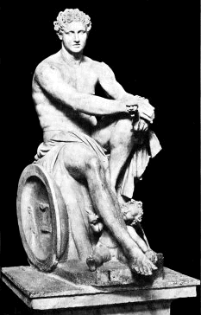
Romulus Deified as Quirinus
After 38 year rule Romulus disappeared
Some claimed Patrician foul play
Official Story: Taken to heaven as a god
Worshipped as Quirinus—a Sabine Storm God

Slide 6
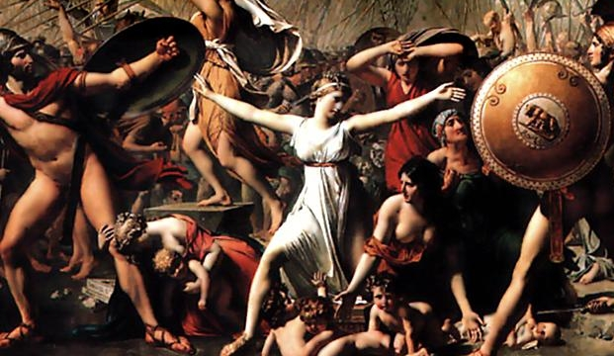
Rape of Sabine Women
Romulus invited Sabines to a festival
Bride Theft and Hospitality
Titus Tatius made war
Sabine women made peace
Cultural Context: Brides were taken from family homes under pretense of force and brought to groom’s home

Slide 7
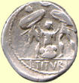
Traitorous Woman: Tarpeia
Father was defending the Capital Hill; she led Sabine army in a secret way
Betrayed Romans for “what is on your left arms”; bracelets
Bury her in shields
The place became the “rock of Tarpeia” and traitors were thrown off to their deaths there

Slide 8
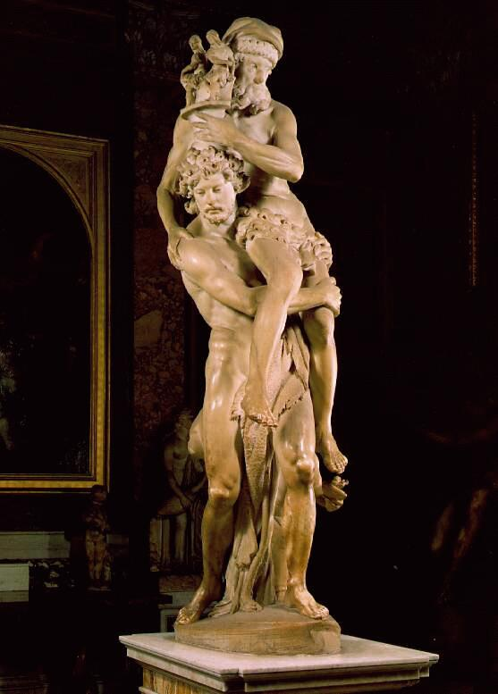
Roman Hero: Aeneas
Divinity of Julius Caesar and Augustus from Venus, through Iulus (Iulian line)
Pietas: Duty to family, State, and Religion
Gravitas: Seriousness of Purpose and Duty
Frugalitas: Ideal of Simple Life
Emotional Restraint
Subordination of Individual

Slide 9
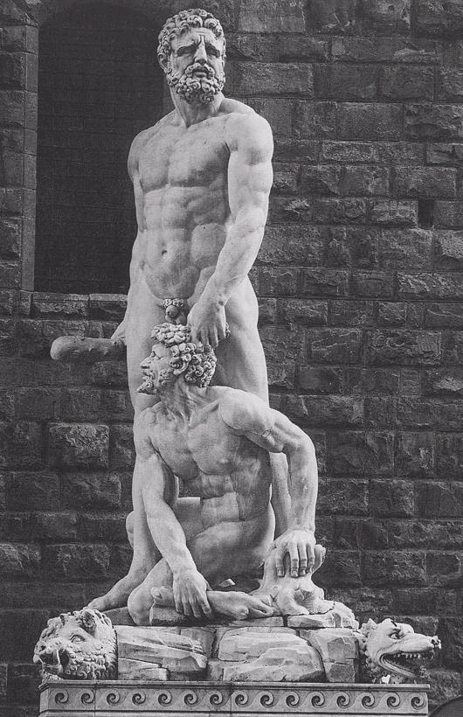
Hercules and Cacus
Cacus, a giant who had a cave on Mt. Aventine
Hercules Stole the cattle of Geryon; Cacus stole them from Hercules
Hercules is symbol of civilization who removed a troublesome thief
Ara Maxima founded at site of Forum Boarium, Cattle Market of Rome

Slide 10
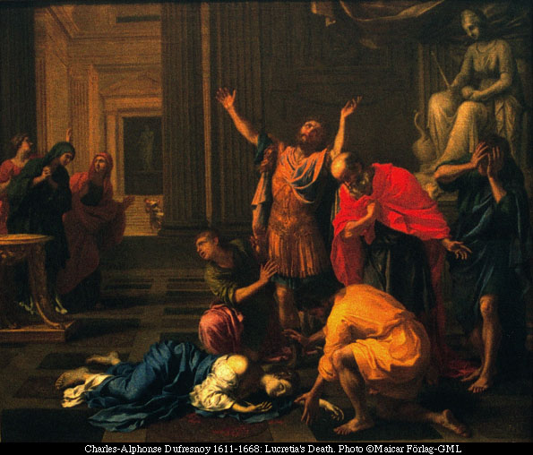
Rape of Lucretia
Contest of best wife: Lucretia busy at loom while others are feasting
Raped by Etruscan Prince
Livy, “They tell her it is the mind that sins, not the body; and that where purpose has been wanting there is no guilt.
"It is for you to determine," she answers, "what is due to him, for my own part, though I acquit myself of the sin, I do not absolve myself from punishment; nor in time to come shall ever unchaste woman live through the example of Lucretia."

Slide 11
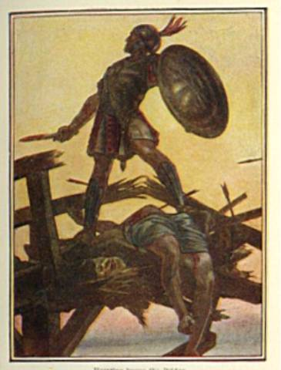
Horatius Cocles
Etruscans were approaching city
Defended the Sublican bridge
Prayer to Tiber: “Then Cocles said,.“Tiberinus, Holy Father, I pray thee to receive into they propitious stream these arms and this warrior”
Symbol of Courage and Piety

Slide 12
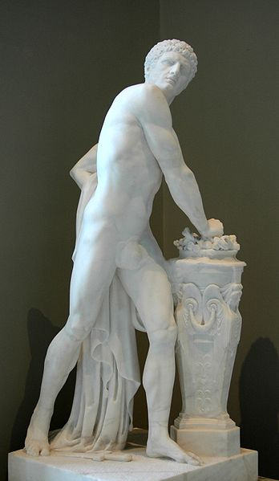
Mucius Scaevola (Lefty)
Attempted to steal into Etruscan camp
Assassination attempt
Captured
Thrust his hand into fire in contempt of death
King let him go out of respect!

Slide 13
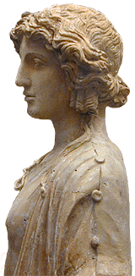
Cloelia and the Hostages
Peace Treaty: Roman hostages sent to Etruscans
Cloelia led women to escape
King so respected her bravery he allowed her to take more hostages back with her and she choose young men
Equestrian statue was erected in her honor on Sacred Way
Roman Women are as brave as Roman Men

Slide 14
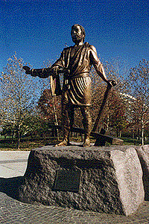
Cincinnatus
At work in fields, drops his plow to come to aid of Rome. Made Tyrant to fight Aequians
Upon winning the war he dropped his armor and picked up the plow again
Symbolized the simplicity of early Romans who valued patriotism but were not power hungry or greedy.

Slide 15
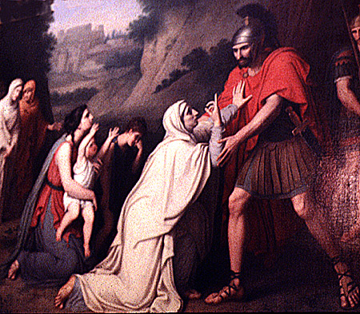
Coriolanus
Leader of Rome; expelled as a tyrant by the Plebeians
Led the Volscian Army against Rome
Mother appealed to him not to attack; “my son, thou shalt enter Rome only over my dead body.” “Mother, thou hast saved Rome, and lost a son”
Killed by Volscians

Slide 16
Observations on Roman Values
Pietas: Duty
Gravitas: Oath Keeping
Frugalitas: Simplicity
Fratricide a metaphor for conflict between Patricians and Plebeians
Role of Mother: Sacrifice and Loyalty (Tarpeia contrasts with Coriolanus’ Mother, Sabine Women, and Lucretia)

